Slide 1
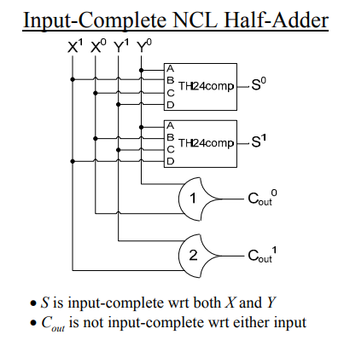
1.
2.
3.
4.
Netlist:
27 1 5 4 1 2 3
27 1 6 4 2 3 1
1 1 7 4 2
2 1 8 3 1
5.
6.
7.
TH12
8.
TH22

Slide 2
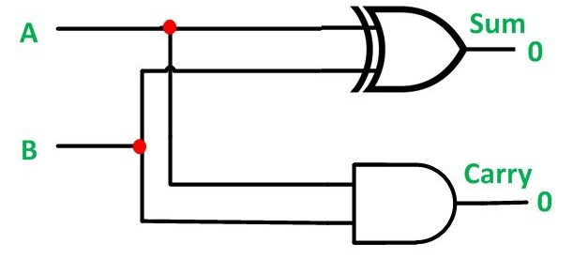
Synchronous Half Adder
Netlist:
6 1 3 1 2
1 1 4 1 2
1.
3.
2.
4.

